Slide 1


Welcome to
UNC Chapel Hill Bootcamp
Wifi Name: wpu conference events
Password: wpuevents
Accept Invite:
github.com/CodingBootcamp
Open:
Slack Desktop App & Add Photo!
Get up and play Bingo!
Notes:
Overlay and border color needs to change. Create a master theme that changes all slides.
Need instructions for updating the deck for each launch (assuming it has the Uni theme applied) *create those.
i.e.: Review slides x,x,x and complete with local market information
Scripted Welcome and Open
Hello everyone and welcome to your first day of class! Congratulations for taking the first step of this journey with us! Today we will be focusing on building community in the classroom, finding common ground, and forming a collaborative learning environment with each other.
By the end of this class, we will be working with the very basics of Terminal/Console and HTML. But before we dive into the coding portion of today’s lesson, we will be taking some time to introduce you to the some of the very important details that you will need to know about this program.

Slide 2
Congratulations!
Tonight’s Focus:
Community in the classroom
Finding Common Ground
Forming a Collaborative learning environment.
Notes:
Overlay and border color needs to change. Create a master theme that changes all slides.
Need instructions for updating the deck for each launch (assuming it has the Uni theme applied) *create those.
i.e.: Review slides x,x,x and complete with local market information
Scripted Welcome and Open
Hello everyone and welcome to your first day of class! Congratulations for taking the first step of this journey with us! Today we will be focusing on building community in the classroom, finding common ground, and forming a collaborative learning environment with each other.
By the end of this class, we will be working with the very basics of Terminal/Console and HTML. But before we dive into the coding portion of today’s lesson, we will be taking some time to introduce you to the some of the very important details that you will need to know about this program.

Slide 3
Activity: Present & Accounted For
Navigate to www.bootcampspot.com
Sign in
Click Sessions
Find Today’s Date
Mark Your Attendance
Notes:
Everyone open your browser and let’s follow these steps:
Navigate to www.bootcampspot.com
Sign in with your log-in credentials
Click “Sessions”
Find Today’s Date
And last but not least, let’s mark the official start of our journey together!
Everyone Mark Your Attendance

Slide 4
By the end of this session, you will:
Come to know your classmates as the community that you will rely on for collaborative learning.
Know the staff who will be providing holistic support throughout the program.
Understand the minimum requirements in order to successfully graduate from this boot camp.
Be able to list ways to get help and support at your moments of need.
Notes:
SSM should call on a student to read each objective out loud

Slide 5
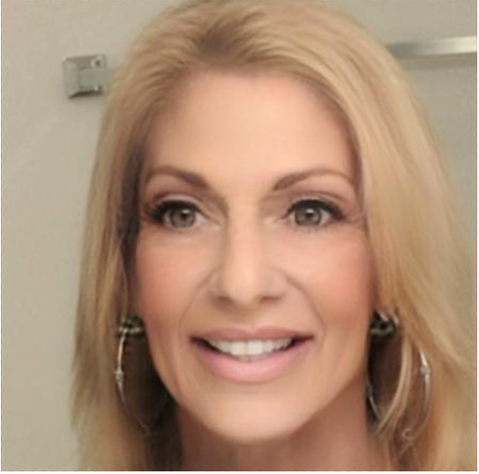
Lisa Shemancik
Student Success Manager
My goal is to help you successfully complete the program
Single Mom of 2 Teenage Boys . I love the beach and Pizza!
You can reach me at lshemancik@bootcampspot.com
Notes:
I’d like to begin by introducing myself.
My name is [_Insert SSM Name_] and I am your Student Success Manager for this course.
My goal is to help you successfully complete the program
[_Insert Fun Fact_]
You can reach me at [__Insert Email___]@bootcampspot.com
We’re are also joined today by [_Insert University Partner: Name and Title_] who would like to say a few words to welcome you to this boot camp.

Slide 6

Your turn!
In 30 seconds or less, please share:
Name
Location (Live and Commuting from)
Background (Career, Education, Interests)
One Fun Fact about yourself
Notes:
Now it's your turn! We’d like to invite each of you to stand and share...
Your Name
From what area you may be commuting
A brief description of your background, such as, Career and Interests.
A fun fact about yourself
****Student Intro’s****
Let’s, also, get to know some of the individuals who will be supporting you along the way.

Slide 7
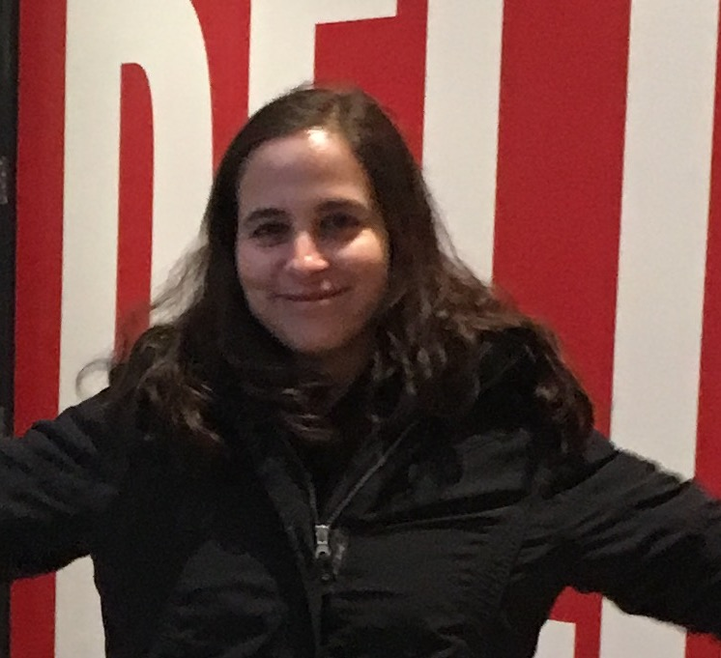
Maria Wong
Teaching Assistant
Background: Master of Education, North Carolina State University
Workplace: Software Developer, Crawfish Apps
UNC Bootcamp Alumni
Fun Fact: I am a Girl Scout Leader and I enjoy boating

Slide 8

John Ingles
Teaching Assistant
Background: Physics
Workplace: Data Analyst
Alumni of Illinois Institute of Technology and Udacity
Fun Fact: I know approximately 3500 words in Japanese

Slide 9

Joshua Pinos
Instructor
Education: BS Computer Science, Fayetteville State University
Workplace: Software Staff Engineer, Lenovo
Prior Teaching Assistant and Instructor
Fun Fact: I love cars, weightlifting, and programming late into the night. I am also a military brat.

Slide 10


YOUR
CAREER SERVICES TEAM
PROFILE COACHES
CAREER COACH
YOU
Notes:
Keep stock images. Your Career Services Team is made up of multiple members who work with you to help achieve a status that we refer to as Employer Competitive, you can refer to the document we gave you at check-in to learn more about what that means.
For now, let’s meet the team:
Your Profile Coaches provide valuable feedback on career ready tools.
Your Career Coach is there to provide you with training and various career-readiness elements that will make you more competitive in your job search.
Lastly, the third and most important member of your Career Services Team, is You. Our team is here to empower you with the tools and resources to find meaningful employment but you are the key player in your own success.
Stay tuned for an announcement regarding the first Career Services Meet-and-Greet on the BootcampSpot Announcement Wall.

Slide 11


SUPPORT STRATEGIES
You are responsible for your success, but you’re not alone!
You
Schedule a Check-in with your SSM
Live Chat
on Bootcampspot
Attend Office Hours
Form Study Groups
Notes:
This is called a "boot camp" for a reason, you can expect highly challenging work that will require a commitment from you both inside and outside of the classroom. In fact, you can expect to devote even more time outside of the classroom than you do inside, focusing on homework assignments, group projects, and additional study and exercises.
But don’t worry! Yes, you are responsible for your own success, but you, are definitely not alone.
We offer Live Chat Support for needs such as:
Financial issues
Tutoring
General Support
FAQs
We urge you to attend:
Office Hours [_SSM Should List Times_]
Form Study Groups
Schedule Check-ins with myself to look for ways that I be helpful to your success.
The great thing about Study Groups is that they’re a key component of the support you’re able to build for your own success in this program. They allow you to work through roadblocks with your classmates and build the collaborative learning community that we referenced in our objectives. Which brings us to our next step, bringing this community to life.

Slide 12
Activity: Landing Zones
Read this, then break into groups. (We’ll direct you)
2. As a group, decide on a meeting time and place for your study group on your assigned day of the week.
3. Post day and location in your Slack and pin.
4. Choose a speaker to share your decision with the class.

Slide 13
Minimum Graduation Requirements:
Miss no more than 4 classes
Have no more than 2 incomplete homeworks
Hold at least a 70% average on homeworks
Participate in all projects
Balance paid in full
Notes:
SSM should call on a student to read each Graduation Requirement out loud.
Remove % if not applicable to your university

Slide 14

Let’s Review What We’ve Covered So Far:
Come to know your classmates as the community that you will rely on for collaborative learning.
Know the staff who will be providing holistic support throughout the program.
Understand the minimum requirements in order to successfully graduate from this bootcamp.
Be able to list ways to get help and support at your moments of need.
Notes:
Before we close this portion of today’s session, let’s take a look at some of the Objectives we set out to achieve during this session.
We’ve come to know your classmates as the community that you will rely on for collaborative learning.
We’ve met the staff who will be providing holistic support throughout the program.
We understand the minimum requirements in order to successfully graduate from this bootcamp.
We listed ways to get help and support at your moments of need.

Slide 15

Break
See you back in 15 minutes!

Slide 16
Thought Experiment #1
The Great Debate
Notes:
It’s important to keep in mind why you joined this class. Let’s talk about your goals.

Slide 17
It’s time for a group activity!

Slide 18
Form a group of 3-4 students. (Psst… They shouldn’t be someone right next to you)

Slide 19

Imagine… Your entire bonus rests on answering this next question.

Slide 20


The Question…
Which do Americans prefer:
Italian or Mexican food?

Slide 21
> YOUR TURN!
Activity: The Great Debate | Suggested Time: 15 min
Assignment:
With your group develop a complete strategy for answering this question with as much confidence possible. Specifically, answer questions like:
What data will you attempt to gather?
What relationships will you be looking for?
How will you ensure your answer is most likely “true”?
Assumptions:
You are given 5 hours and a budget of $10 to accomplish this.
Your answer will be tested by randomly selecting 9 Americans who will each be asked the question – with 0 qualifiers.
You only have your team.
Be prepared to share! (P.S. Your answer had better not be: “We Googled it”)

Slide 22
Thought Experiment #1
The Great Debate (Analyzed)
Notes:
It’s important to keep in mind why you joined this class. Let’s talk about your goals.

Slide 23
Step 1: Decompose the Ask

Slide 24
Step 1: Decompose the “Ask”
Which do Americans prefer:
Italian or Mexican food?

Slide 25
Step 1: Decompose the “Ask”
Which do Americans prefer:
Italian or Mexican food?

Slide 26
Step 1: Decompose the “Ask”
Which do Americans prefer:
Italian or Mexican food?
Questions it Raises:
Who exactly is an American?
Are Americans just white, forty-year old males?
Do Americans just live in big cities?
Are Americans just millennials?
Obviously not. So, how can we get a representative sample of Americans?

Slide 27
Step 1: Decompose the “Ask”
Which do Americans prefer:
Italian or Mexican food?

Slide 28
Step 1: Decompose the “Ask”
Which do Americans prefer:
Italian or Mexican food?
Questions it Raises:
How do we define “preference”?
Do people prefer the foods they eat most frequently?
Do people prefer the foods they wish they could eat if cost was not an issue?
How uniform is the preference? Is it regionalized? Is it different by demographic?
Inherently, preference is subjective. We are going to need to make it objective.

Slide 29
Step 1: Decompose the “Ask”
Which do Americans prefer:
Italian or Mexican food?

Slide 30
Step 1: Decompose the “Ask”
Which do Americans prefer:
Italian or Mexican food?
Questions it Raises:
How do we categorize foods? Is Pizza Italian? Is Taco Bell Mexican?
How do we categorize food? Does making pasta at home constitute Italian? Or are we just talking about restaurants?
Are we just talking about “best experiences?” Or are we including poorer renditions of these foods?
These are broad categories we are pursuing. We will have to narrow the scope.

Slide 31
Step 2: Identify Data Sources

Slide 32
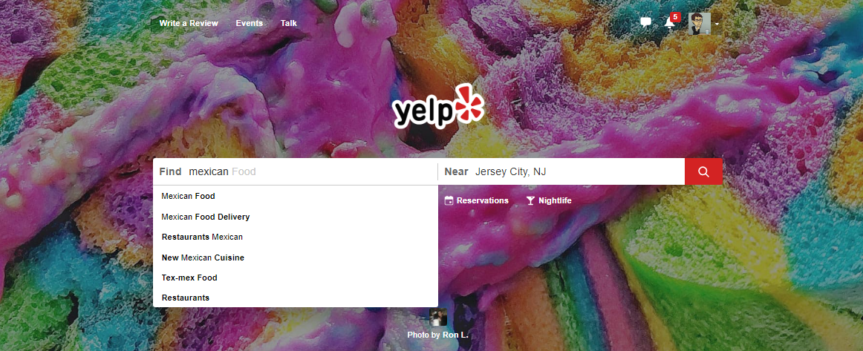
Step 2: Identify Data Sources
As everyday consumers, we are regularly getting a pulse of everyday American food preferences to inform our own decisions. Perhaps we can make use of the same approach?

Slide 33
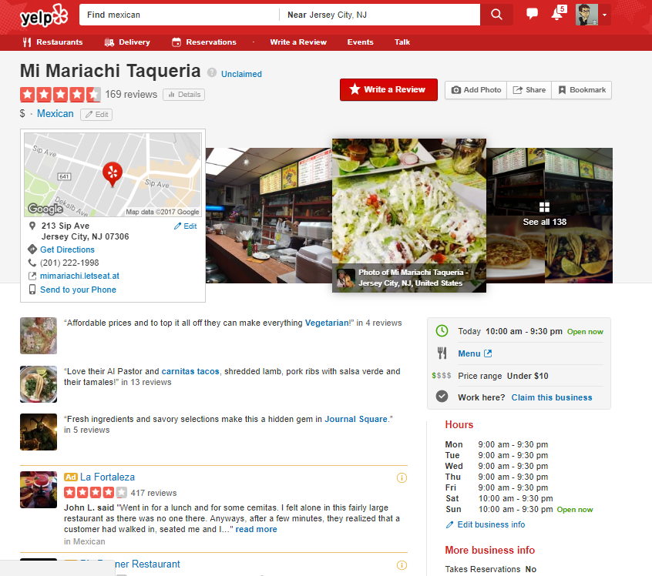
Step 2: Identify Data Sources
Accessing a web service like Yelp provides an almost encyclopedic amount of information on the eating preferences of Americans.

Slide 34

Step 2: Identify Data Sources
Why poll an audience, when there already exist enormous databases of information on American food preferences – readily available online?

Slide 35
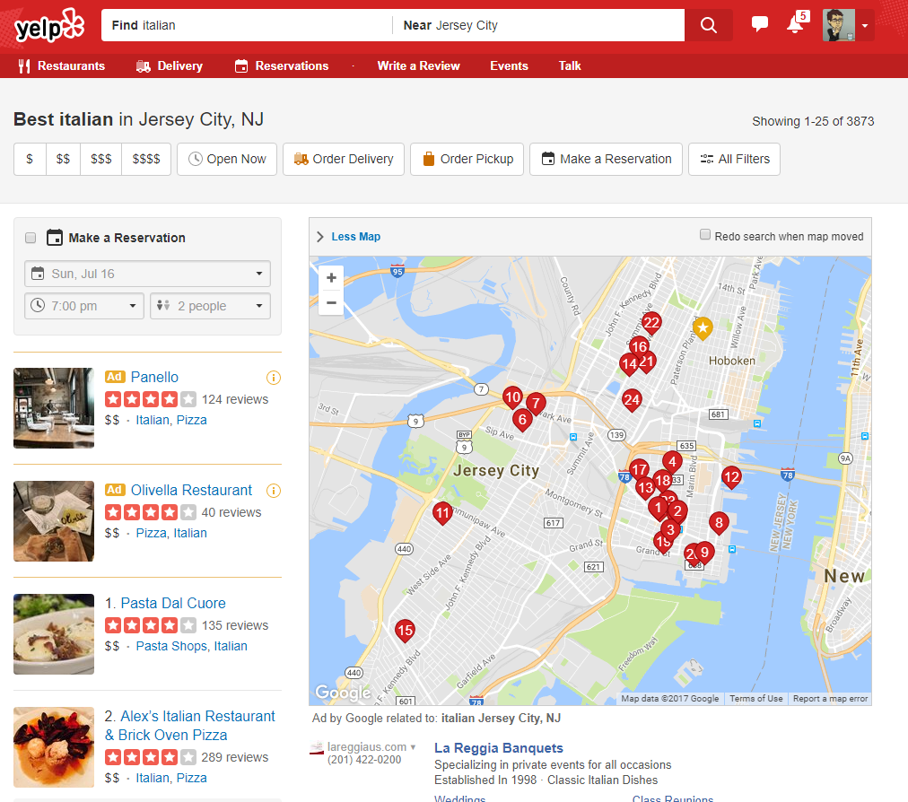
Step 2: Identify Data Sources
Food Type
Location
And LOTS of Data!!
Review Counts
Ratings
Thank you Yelp!!!!

Slide 36
Step 3: Define Strategy and Metrics

Slide 37
Step 3: Define Strategy and Metrics
Here we created a blueprint for what we’re targeting:
Americans:
Ideally we need thousands of records from Americans in hundreds of different cities. (Large samples)
Preference:
Number of Yelp Reviews (More = Preference)
Average Aggregated Ratings (Higher = Preference)
Italian and Mexican Food:
Top 20 Italian and Mexican restaurants in every city.

Slide 38
Step 3: Define Strategy and Metrics
New York
Tucson, AZ
Washington, DC
Italian
Mexican
Italian
Mexican
Italian
Mexican
Restaurant
Restaurant
Restaurant
Restaurant
Restaurant
Restaurant
Restaurant
vs
Restaurant
Restaurant
vs
Restaurant
Restaurant
vs
Restaurant
Restaurant
Restaurant
Restaurant
Restaurant
Restaurant
Restaurant
Restaurant
Restaurant
Restaurant
Restaurant
Restaurant
Restaurant
Restaurant
Restaurant
Restaurant
Restaurant
Restaurant
Restaurant
Omaha, NE
San Diego, CA
Atlanta, GA
Italian
Mexican
Italian
Mexican
Italian
Mexican
Restaurant
Restaurant
Restaurant
Restaurant
Restaurant
Restaurant
Restaurant
Restaurant
Restaurant
Restaurant
Restaurant
vs
Restaurant
vs
Restaurant
vs
Restaurant
Restaurant
Restaurant
Restaurant
Restaurant
Restaurant
Restaurant
Restaurant
Restaurant
Restaurant
Restaurant
Restaurant
Restaurant
Restaurant
Restaurant
Restaurant
Restaurant
Repeat this analysis for as many cities as possible…

Slide 39
Step 4: Build Data Retrieval Plan

Slide 40
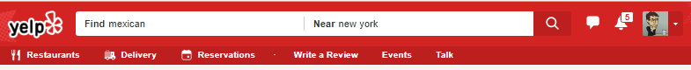
Step 4: Data Retrieval Plan
We could brute force our way to retrieve this data, but…
It would be extremely time consuming
It would be skewed by our city familiarity
It would be manually labor intensive

Slide 41
Step 4: Data Retrieval Plan
Basically… Not in a million years.

Slide 42
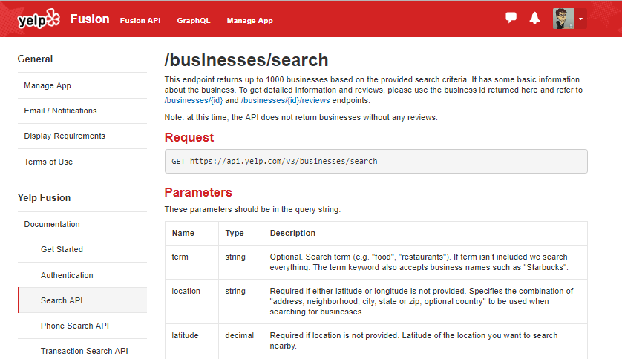
Thank You Yelp!
Thankfully, we can take advantage of the Yelp Fusion API to programmatically run our queries. (#ThankGodForProgramming)

Slide 43
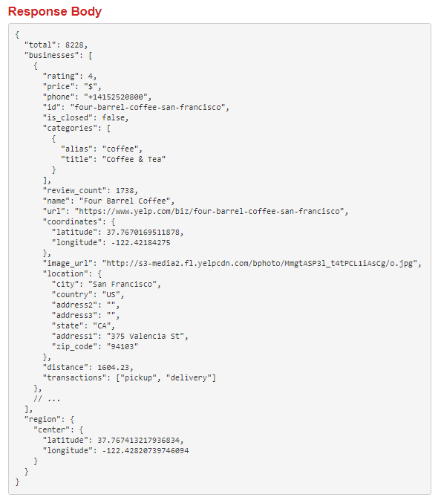

Thank You Yelp!
Thankfully, we can take advantage of the Yelp Fusion API to programmatically run our queries. (#ThankGodForProgramming)

Slide 44


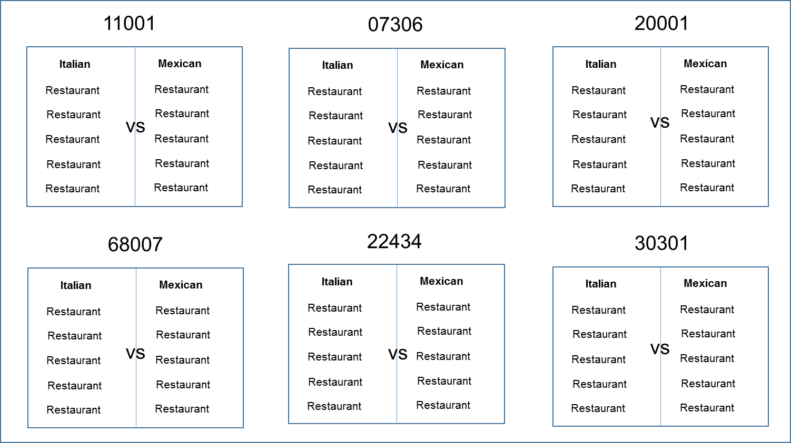

Step 4: Build Data Retrieval Plan
We will build a Python script to randomly select over 700 zip codes from the US Census and then acquire review data from the top 20 Mexican and Italian restaurants for each zip codes using the Yelp API.

Slide 45
Step 5: Retrieve the Data

Slide 46



Pulling with Python
Randomly Select a Zip Code
Save the Output to a Data Frame
Create an API Request

Slide 47
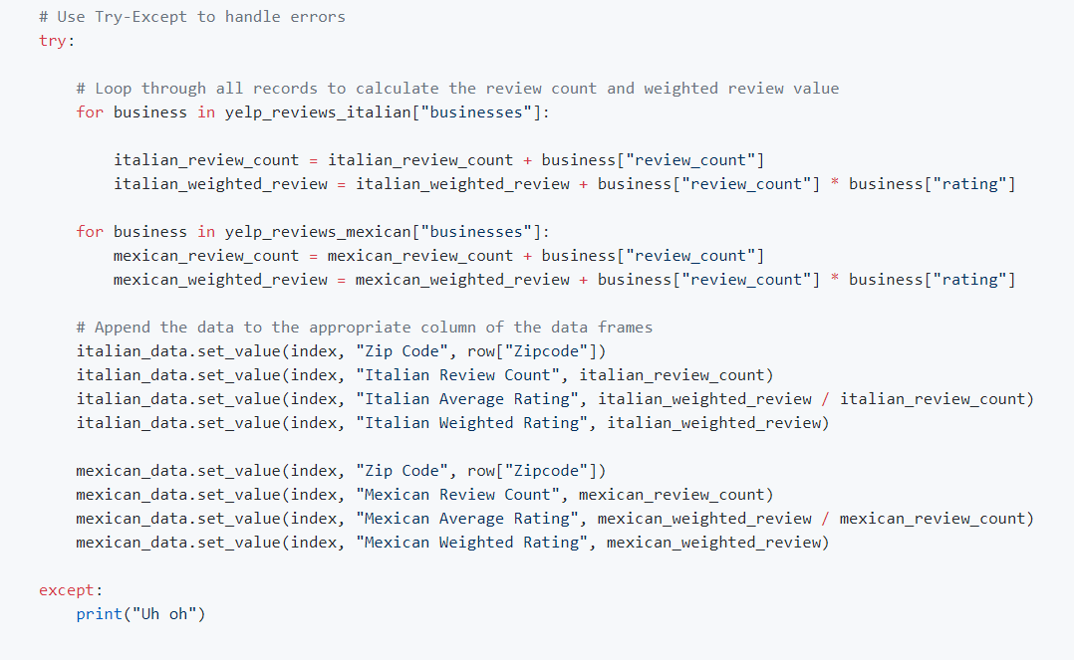
Pulling with Python
This funky code…

Slide 48
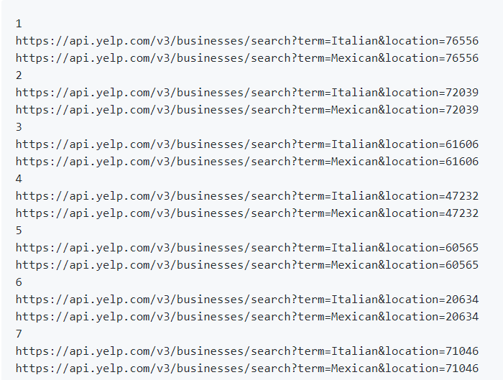
Pulling with Python
Will make all these URLs

Slide 49
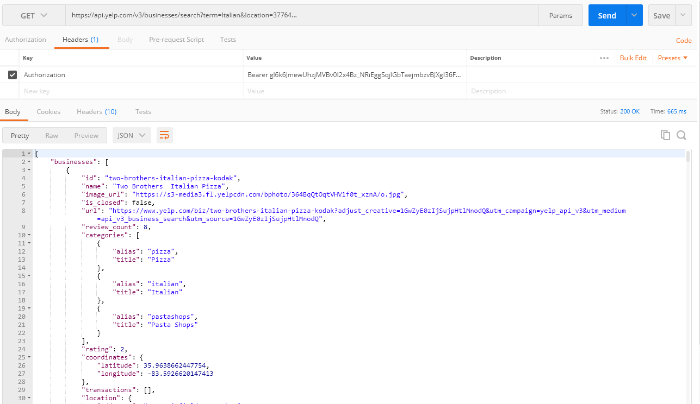
Pulling with Python
And each of these URLs holds a piece of our answer…

Slide 50
Step 6: Assemble and Clean the Data

Slide 51
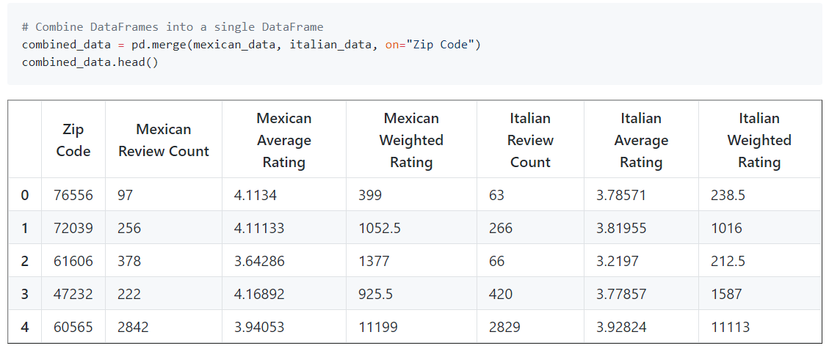
Cleaning with Pandas
No data comes out intrinsically the way you want it to.
In our case, we needed multiple steps to aggregate the data along our channels of interest.

Slide 52
Step 7: Analyze for Trends

Slide 53
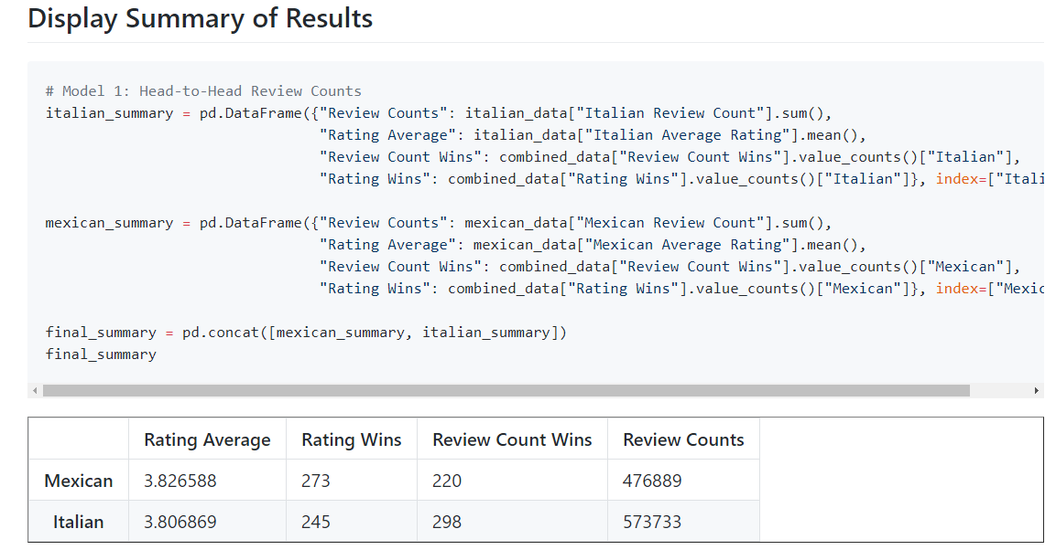
Analyze for Trends (Table)
Ugh..
It’s Close.

Slide 54
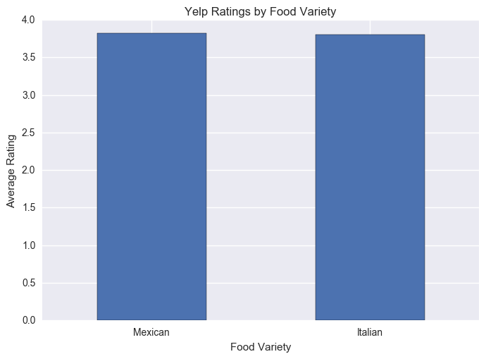
Analyze for Trends (Ratings)
Yelpers Rate Italian and Mexican relatively equally.

Slide 55
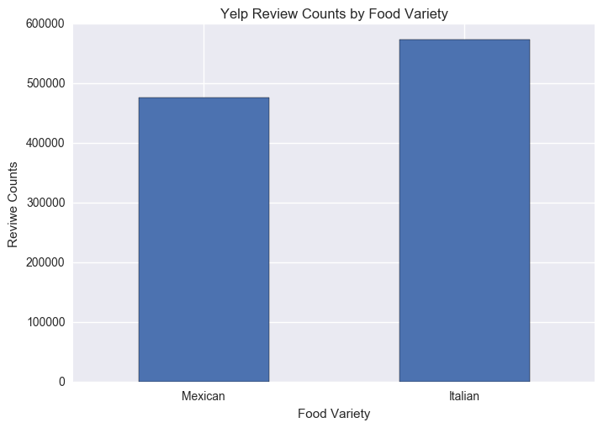
Analyze for Trends (Review Counts)
But… Yelpers seem to significantly review more Italian restaurants.

Slide 56
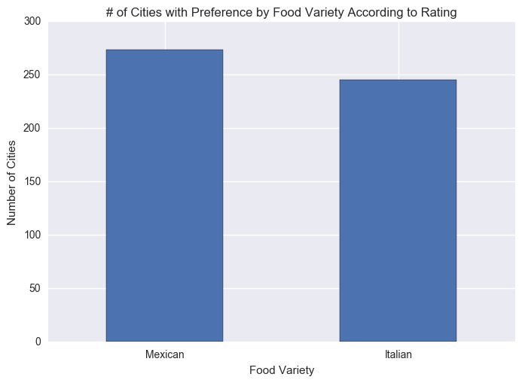
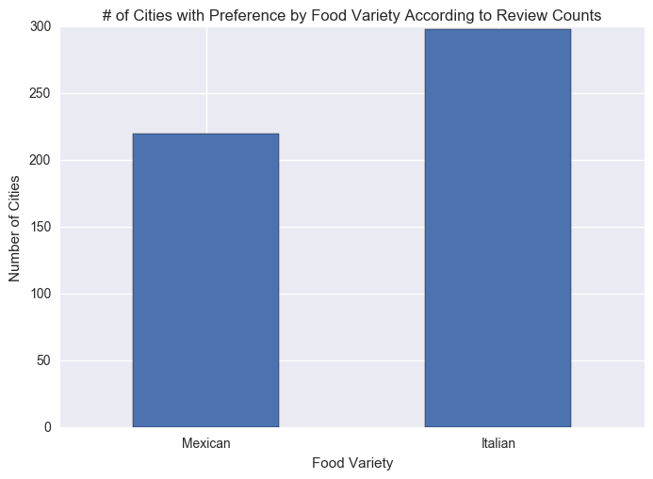
Analyze for Trends (Winner Take All)
Just for kicks I threw in an analysis to ask based on aggregating the data along cities using a “Winner-Take-All” approach.
It’s sort of a wash.

Slide 57
Analyze for Trends (Statistical Analysis)
Metric | Italian | Mexican | p-Value (T-Test)
Average Rating | 3.806 | 3.826 | 0.284
Review Counts | 573k | 476k | 0.057
Because of how close the numbers appear, we utilized a Student’s T-Test to quickly asses if the perceived differences are statistically significant.
The difference in review count is statistically significant.

Slide 58
Step 8: Acknowledge Limitations

Slide 59
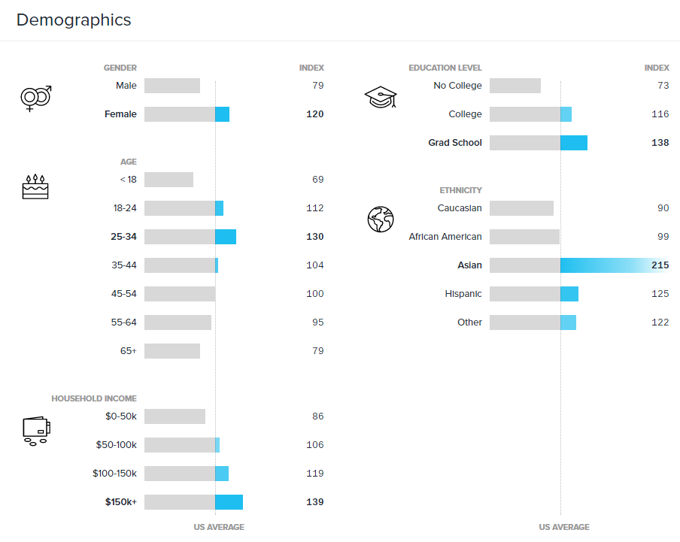
Limitations in Analysis
Yelp demographics may not match the American demographic.

Slide 60
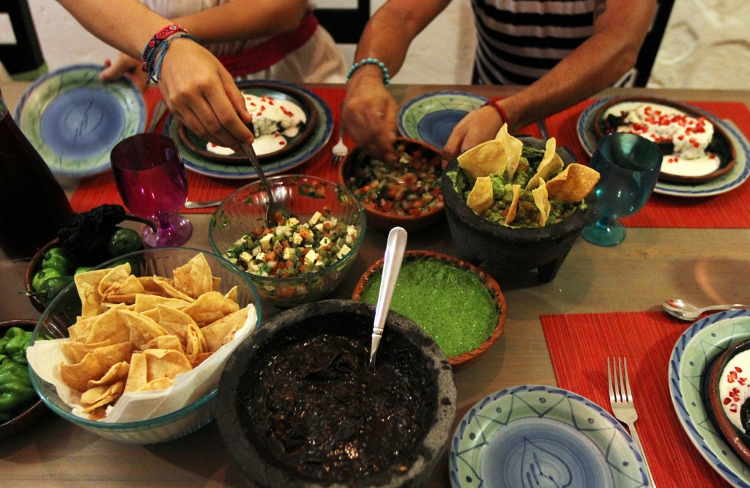
Limitations in Analysis
Restaurant experiences do not equate to home cooked meals.

Slide 61

Limitations in Analysis
“Fine” dining effect?

Slide 62
Step 9: Make the Call

Slide 63
Making the Call
The “Proper” Conclusion:
“Based on our analysis, it is clear that the American preference for Italian and Mexican food are similar in nature. As a whole, Americans rate Mexican and Italian restaurants at statistically similar scores (Avg. score: 3.8, p-value: 0.285). However, there exists statistically significant evidence that Americans write more reviews of Italian restaurants than Mexican (+96k, p-value: 0.057). This may indicate that there is an increased interest in visiting Italian restaurants at an experiential level. However, it may also merely suggest that Yelp users enjoy writing reviews on Italian restaurants more than Mexican restaurants.”

Slide 64
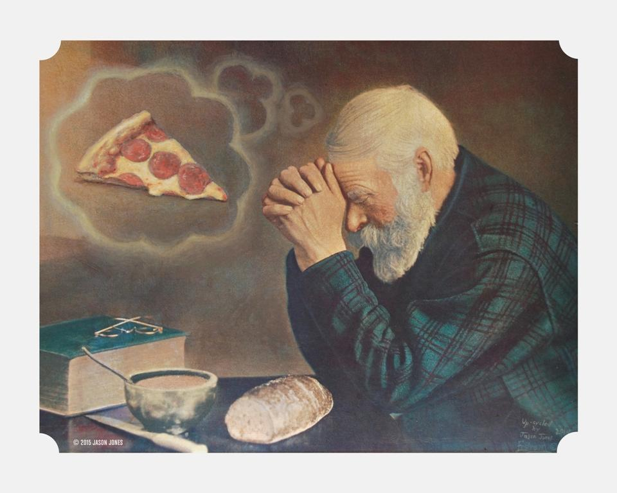
Making the Call
The “Let’s Be Real” Conclusion:
Italian.
(But it’s going to be close…)

Slide 65
> YOUR TURN!
Activity: Analyze the Code | Suggested Time: 10 min
Assignment:
Take a few moments to analyze the code provided over slack. Talk to the people in your group and try to dissect as much as you can.
If you are new to coding, your goal should be to understand what a single line does.
If you are not new to coding, your goal should be to understand the overall flow of activities.
Take a moment to explain what you’ve learned to the people around you.

Slide 66
An Analytics Paradigm
Notes:
It’s important to keep in mind why you joined this class. Let’s talk about your goals.

Slide 67
Analytics Paradigm
Decompose the Ask
Identify Data Sources
Define Strategy and Metrics
Build Data Retrieval Plan
Retrieve the Data
Assemble and Clean
Analyze for Trends
Acknowledge Limitations
Make the Call or
Tell the Story
Regardless of type or industry, this paradigm provides a repeatable pathway for effective data problem solving.

Slide 68
Thought Experiment #2
Predicting Gentrification
Notes:
It’s important to keep in mind why you joined this class. Let’s talk about your goals.

Slide 69
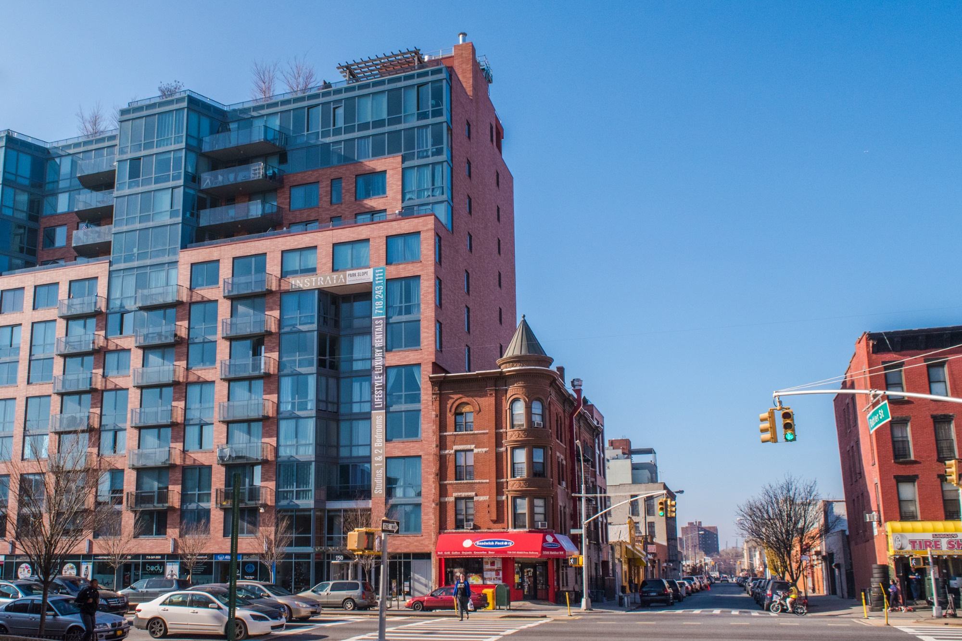
Let’s Talk Gentrification

Slide 70
> YOUR TURN!
Activity: Predicting Gentrification | Suggested Time: 10 min
Assignment:
Using the Analytics Paradigm as a framework, outline a strategy by which you would identify which neighborhoods in our city are seeing signs of gentrification?
Specifically, how would you answer the questions:
What observable signs can we detect to suggest gentrification is happening?
What means can we use to determine how long the trend has been happening?
What “proxies” might we use to identify gentrification in non-obvious ways?
How might you create a visualization of this data to best “tell the story”?
Pay special attention to details like:
What data will you use to build your “model”?
How will you retrieve the data?
What does your final “story” look like?

Slide 71
Prepare for Next Class
Notes:
It’s important to keep in mind why you joined this class. Let’s talk about your goals.

Slide 72
Prepare for Next Class
By Next Class:
Make certain that you have Microsoft Excel installed.
Make certain that you have Slack installed and are actively looking at it.
Figure out where the Git repository for our class is.
Figure out where class videos will be posted.

Slide 73
Homework #1
Notes:
It’s important to keep in mind why you joined this class. Let’s talk about your goals.

Slide 74

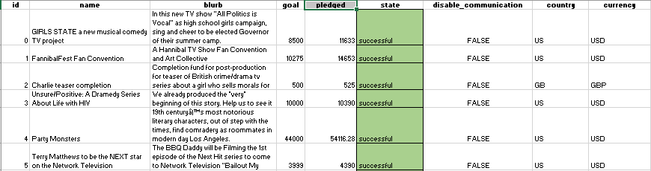
Homework #1 - Introduction
More information to come on Wednesday!

Slide 75
Questions / Discussion
Notes:
It’s important to keep in mind why you joined this class. Let’s talk about your goals.

